Slide 1
Fleischer Brother’s Studio
Ideas, Innovation, Character, Longevity
Notes:
This is a test – can I read this in “Play” mode?

Slide 2

Connections

Slide 3
Connections
Made their own luck, both good and bad

Slide 4
The Fleischer Family
Immigrated from Austria, 1886
Five Sons, One Daughter
Charles & Max (1883): Born in Vienna
Joe, Lou, David (1894), & Ethel: Born in New York

Slide 5
The Fleischer Family
Father Fleischer was a Tailor and an Inventor
“Inventions” included a button, and a yardstick
Got a Patent for a “Hook & Eye”

Slide 6
The Fleischer Family
“The Fleischer boys were sparked by their father to similar yet more complex inventive ability.”

Slide 7
The Fleischer Family
“The Fleischer boys were sparked by their father to similar yet more complex inventive ability.”
Joe: Built a Wireless Telegraph Receiver

Slide 8
The Fleischer Family
“The Fleischer boys were sparked by their father to similar yet more complex inventive ability.”
Joe: Built a Wireless Telegraph Receiver
Tells the family that the “Titanic has sunk.”

Slide 9
The Fleischer Family
“The Fleischer boys were sparked by their father to similar yet more complex inventive ability.”
Charles: Invented the “Clawdigger.”

Slide 10
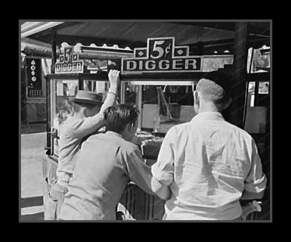
The Fleischer Family

Slide 11
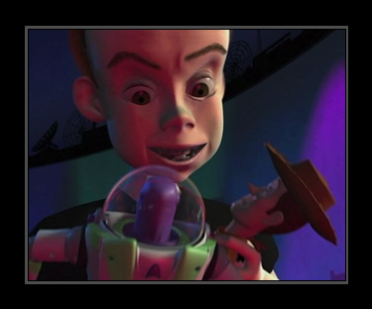
Double Prizes

Slide 12
The Fleischer Family
Music played a central role in their lives
William played the violin
Max the mandolin
Dave wrote and composed
Joe, Lou, & Ethel played the piano
Lou was quite accomplished

Slide 13
The Fleischer Family
Art was also central in their lives.
Max grew up drawing – “Maps for his teachers”
Studied at the Art Student’s League (G. Bridgeman)
Mechanics and Tradesman School Evening High School
Cooper Union
Dave was very visual – “Squares for sugar”
Left Public School – Went to Art School
Worked for his father – “Fashion Copyist”
Played games – “You’ll work for me someday”

Slide 14
Max Fleischer
Work History
Long time goal of working in the Art Department of the Brooklyn Daily Eagle
Offered $2.00 a week to “Sit in on the art department.”
Was hired to run errands at $2.00 a week instead.
Four years later he had worked up to staff artist.

Slide 15
Dave Fleischer
Work History
First job, an usher in New York’s Palace Theater
Left the usher job to work for Walker Engraving Co.
At 18 he became a “Cutter” for Pathe Films

Slide 16
Max Fleischer
Now a staff artist, Max meets John Randolph Bray, a senior staff artist at the Eagle.
They evidently get along well.

Slide 17
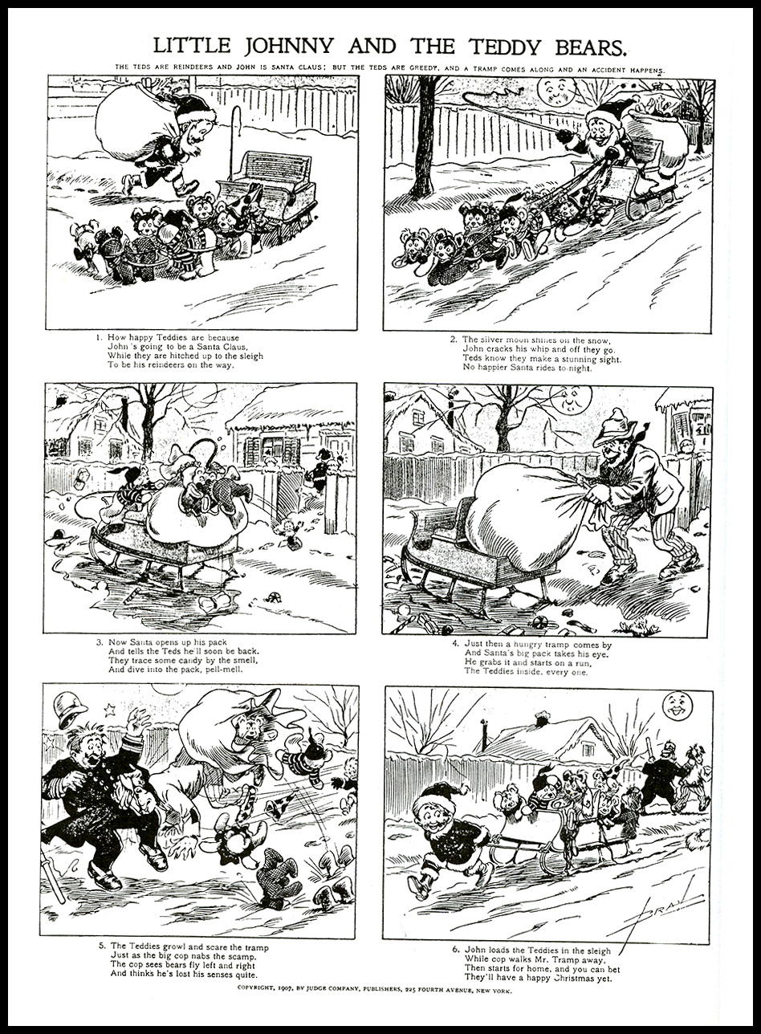

Slide 18
Max Fleischer
Between 1900 and 1902 both John Randolph Bray and Max Fleischer leave the Eagle.
Bray begins a Freelance Career
Max goes to Boston

Slide 19
Max Fleischer
Skip Ahead to 1911

Slide 20
Max & Dave Fleischer
Enter Winsor McCay (“Man’s Greatest Disease is Laziness”)
Little Nemo Animation – first seen in 1910/1911
People thought the images were real children.

Slide 21
Max & Dave Fleischer
McCay will go on to produce Gertie the Dinosaur
First seen in 1914

Slide 22
Max & Dave Fleischer
John Randolph Bray sees something in McCay’s early work that the man-on-the-street does not.
He recognizes the commercial potential.
Interviews McCay about the animation process.
Produces “The Artist’s Dream,” in only one year
Shows it to Charles Pathe
Pathe is so excited he cancels a European trip.

Slide 23
Max & Dave Fleischer
Bray signs with Pathe, begins Heezaliar series
Heezaliar becomes the first character created expressly for cartoon animation.

Slide 24
Max & Dave Fleischer
In 1914 Max returns to New York
Hired by the Crouse-Hines Corporation in Syracuse.
“Max was a commercial artist, and there were none better nor faster.” – Kenneth Mackall (co worker)

Slide 25
Max & Dave Fleischer
Leaves Crouse-Hinds within a year.
Becomes Art Editor at the Popular Science Monthly.
He writes and illustrates articles on the latest inventions
Has a “… keen and instinctive sense for mechanics. To me machinery was also an art form.”

Slide 26
Connections
Aesthetics and Technology
This combination is seen over and over again. From the earliest work by both foreign and US filmmakers and animators, advancements in technology has brought about innovations in the making of animated films and the telling of stories through the medium.
This continues to be constant into the 21st century.

Slide 27
Max & Dave Fleischer
Max recognized that there were “difficulties” in creating an effective illusion of movement.
Time is the real sticking point (even though he didn’t realize this.)
Came up with the idea, and designed a mechanism to achieve fluid motion by tracing live action.

Slide 28
Max & Dave Fleischer
Dave put on the clown costume
Work began in 1915, was completed in about a year.
The patent for the Rotoscope was granted in 1917.
“Out of the Inkwell.”

Slide 29
Max & Dave Fleischer
Max takes the film to Charles Pathe
By this time, Bray has moved from Pathe to Paramount.
Pathe likes the work (but cancels no trips this time)
“So how long did that take?”

Slide 30
Max & Dave Fleischer
Max takes the film to Charles Pathe
By this time, Bray has moved from Pathe to Paramount.
Pathe likes the work (but cancels no trips this time)
“So how long did that take?”
“Now, if you could do that in a week, then you would have something.”

Slide 31
Max & Dave Fleischer
Max leaves dejected, but returns after putting some thought into it, and decides they can speed up the process. Maybe they could turn out a cartoon a month.
Pathe hires them, but they loose that job when the first cartoon is delivered.
Max had insisted they make a Political Cartoon about Teddy Roosevelt’s hunting adventures.
Dave: “They like the clown, we should stick with it.”

Slide 32
Max & Dave Fleischer
Hy Meyer had also just produced a Political Animated Cartoon about Roosevelt for Universal. “It was pretty good, but the same could not be said for that first Fleischer Bros’ version.” – Otto Messmer

Slide 33
Max & Dave Fleischer
Max, after a reasonable period of depression, makes the rounds to all the Motion Picture Companies.
Ends up at Paramount, waiting in a lobby to see Adolf Zukor, the President of the corporation.
In walks John Randolph Bray
Max tells him he has something new.

Slide 34
Max & Dave Fleischer
Bray hires the Fleischers to make cartoons for his “Bray Pictograph.”
This is a screen magazine which has a sports feature, a travelogue, a fashion feature, and a cartoon.

Slide 35
Max & Dave Fleischer
Bray has Paul Terry (Terrytoones), Earl Hurd (Bobby Bumps), and now the Fleischers (Koko), along with his own Colonel Heezaliar.
Each is to produce a cartoon a month, which gives him a new title every week.

Slide 36
Max & Dave Fleischer
Koko is just getting started when the US declares war on the axis powers and sends troops to Europe.
Dave dons a uniform.

Slide 37
Max & Dave Fleischer
Bray has an idea – makes a training film and takes it to General Staff of the US Army in Washington.
The studio is hired to make a series of these films.
Max and J. Leventhal are sent to Ft. Sill OK.
Max comes up with a unique way to teach map reading with a animated film.

Slide 38
Max & Dave Fleischer
Jump to Post WWI

Slide 39
Max & Dave Fleischer
Max resigns his position with the Bray Processing Company, and opens a studio with Dave, his brother in a New York City basement apartment.

Slide 40
Max & Dave Fleischer
Max resigns his position with the Bray Processing Company, and opens a studio with Dave, his brother in a New York City basement apartment.
Shoot some of their film in the living room.
They hire one employee, Charlie Shettler (he will stay with the studio for 20 years).
They begin to produce the Out of the Inkwell series in earnest.

Slide 41
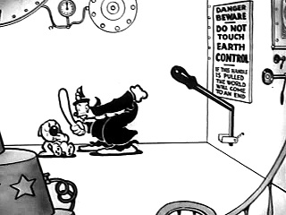
Max & Dave Fleischer
By 1923 the Inkwell shorts are in demand, the studio staff has grown to 19 and they have a new location: 1600 Broadway.

Slide 42
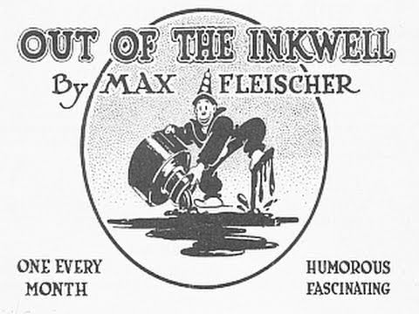
Max & Dave Fleischer

Slide 43
Max & Dave Fleischer
Partner with Lee Deforest – a sound pioneer.
Release the first synchronized sound cartoon, My Old Kentucky Home, in 1926.

Slide 44
Max & Dave Fleischer
Partner with Lee Deforest – a sound pioneer.
Release the first synchronized sound cartoon, My Old Kentucky Home, in 1926.
Began the Bouncing Ball shorts, which were wildly popular.

Slide 45
Max & Dave Fleischer
Partner with Lee Deforest – a sound pioneer.
Release the first synchronized sound cartoon, My Old Kentucky Home, in 1926.
Began the Bouncing Ball shorts, which were wildly popular.
Would work with jazz legends, Cab Calloway, Don Redman, Louis Armstrong.

Slide 46
Max & Dave Fleischer
1929 signed a distribution deal with Paramount.
Changed the studio name to Fleischer Brothers.

Slide 47
Max & Dave Fleischer
Gave us Koko, Betty Boop, Bimbo, Popeye, and Superman!

Slide 48
Max & Dave Fleischer
Gave us Koko, Betty Boop, Bimbo, Popeye, and Superman!
They also help us to understand a little more about the importance of cartoons in society.

Slide 49
Max & Dave Fleischer
Gave us Koko, Betty Boop, Bimbo, Popeye, and Superman!
They also help us to understand a little more about the importance of cartoons in society.

Slide 50
Cartoon & Everyday Life
You may recall:
Mickey Mouse saved the Lionel Model Train Co., when it’s Mickey Car was released during the depression

Slide 51
Cartoon & Everyday Life
You may recall:
Mickey Mouse saved the Lionel Model Train Co., when it’s Mickey Car was released during the depression
Popeye had a spinach obsession from his newspaper comic days, but it became an indispensable plot device in his later animated adventures. U.S. spinach growers credited Popeye with a 33 percent increase in U.S. spinach consumption and for saving the spinach industry in the 1930s.

Slide 52
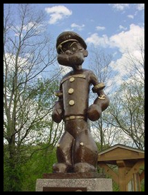
In 1937, the self-proclaimed spinach capital, Crystal City, Texas, erected a statue to honor E.C. Segar and Popeye for their positive influence on America’s eating habits, making Popeye the first cartoon character ever immortalized in public sculpture.

Slide 53
Max & Dave Fleischer
Gulliver’s Travels, Mr. Bug Goes to Town

Slide 54
Fleischer Studios
That’s All Folks. It’s time to watch cartoons.

